Slide 1
FINAL PROJECT
CV (Resume)
Spreadsheet (Analise)
By
AMNA MUKHTAR

Slide 2
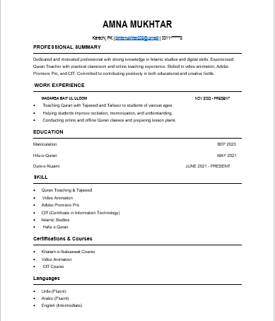
My CV(Resume)
Consists of six sections which includes my academic and professional details.
By
AMNA MUKHTAR

Slide 3
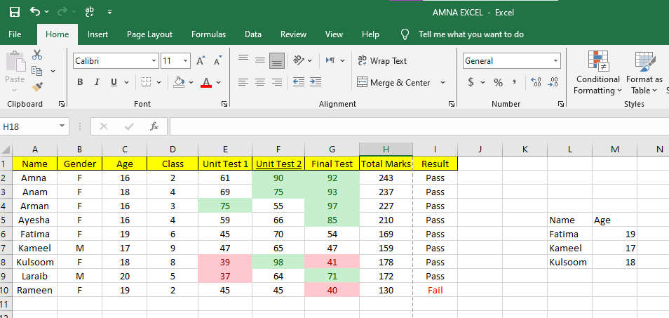
Spread Sheet (Analise)
In Excel
By
AMNA MUKHTAR

Slide 4
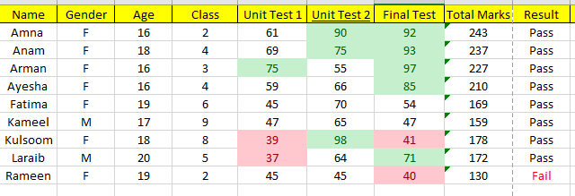
Conditional Formatting
Marks less than 45 are highlighted in red
Marks Greater than 70 highlight in green
By
AMNA MUKHTAR

Slide 5
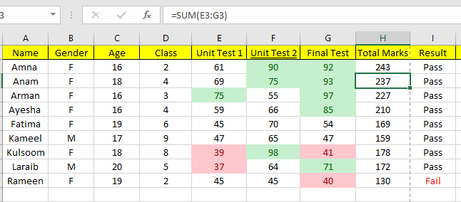
SUM Formula
Calculates the total of all marks.
By
AMNA MUKHTAR

Slide 6
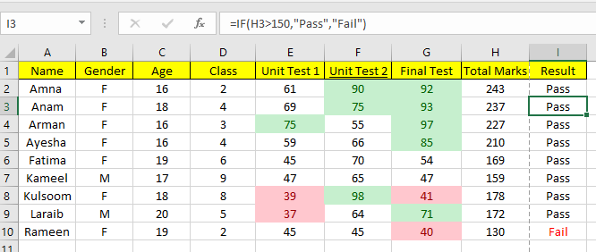
IF Formula
Displays “Pass” if marks > 150, otherwise “Fail”.
By
AMNA MUKHTAR

Slide 7
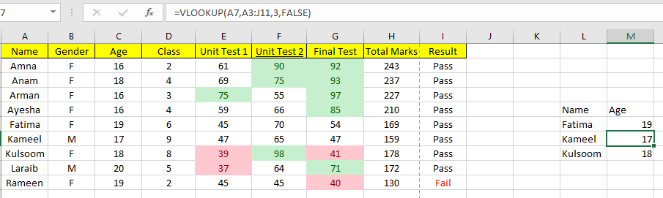
VLOOKUP Formula
Looks up student names by their Age.
By
AMNA MUKHTAR

Slide 8
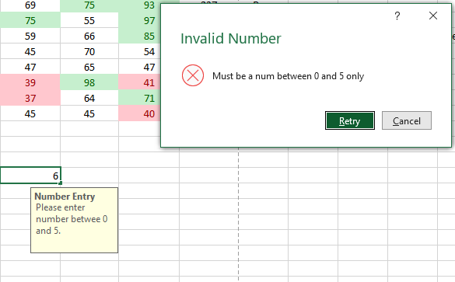
Data validation (Marks)
Allows only Value between 0 and 5.
By
AMNA MUKHTAR

